Slide 1
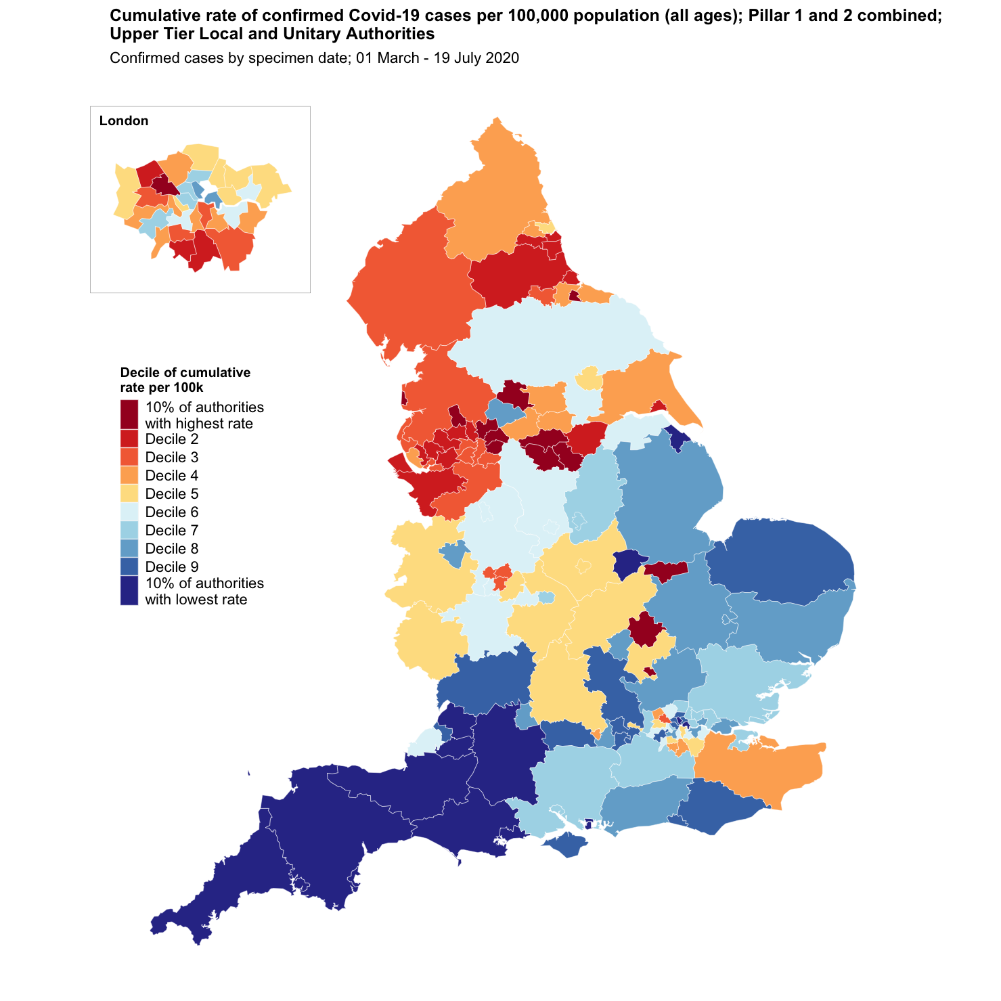
West Sussex Local Outbreak Control Plan
West Sussex County Council
Confirmed Cases UTLA
Cumulative rate of COVID-19 cases per 100,000 population tested under Pillar 1 and 2, by upper-tier local authority
Cumulative Cases as at 19th July 2020
Name | Cases | Rate per 100,000 residents | Local Authority Rank (out of 149) where 1 = Highest Rate per 100,000 | Decile of rate per 100,000
West Sussex | 2,744 | 317.6 | 119th | Decile 8
England | 254,120 | 451.5 | - | -
South East region | 34,694 | 377.9 | - | -
Source: https://coronavirus.data.gov.uk/
Data accessed July 21st 2020
What is a decile?
We have ranked every area in England from highest to lowest rate of confirmed COVID-19 cases and divided the total number of areas into 10 groups each representing 10% of the areas in England.
West Sussex is in the 8th decile.
Pack Date: 21 July 2020

Slide 2
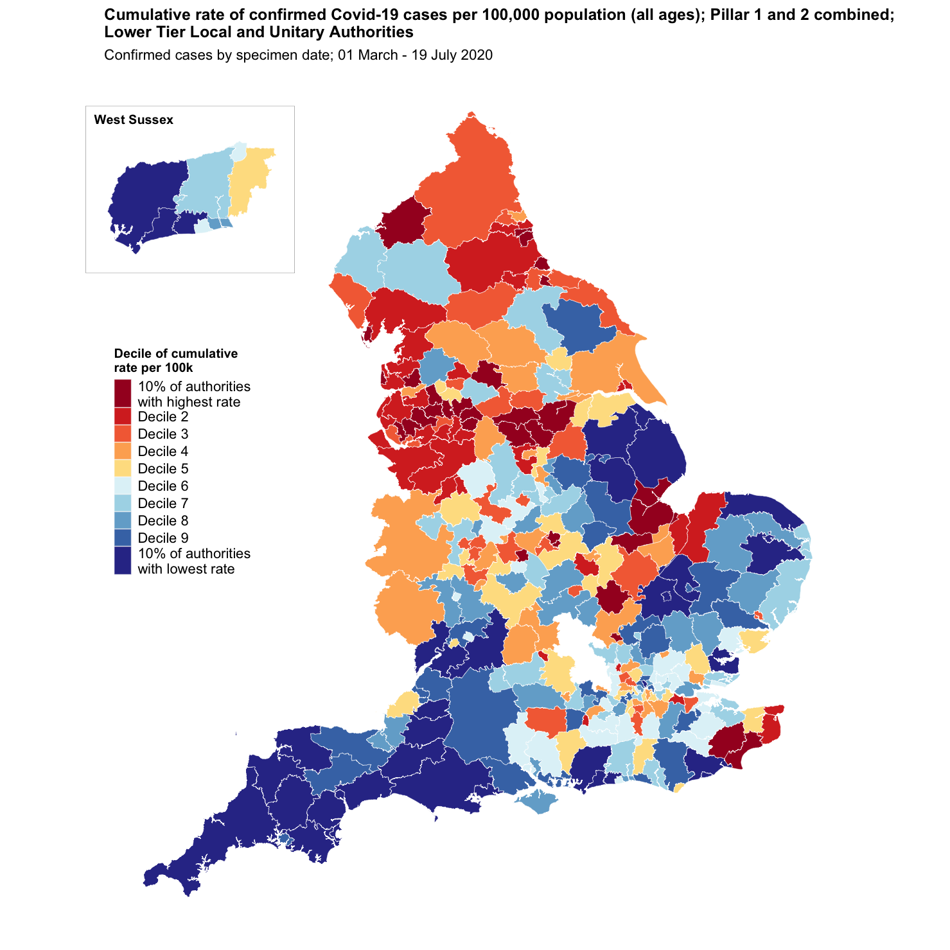
West Sussex Local Outbreak Control Plan
West Sussex County Council
Confirmed Cases LTLA
Cumulative rate of COVID-19 cases per 100,000 population tested under Pillar 1 and 2, by lower-tier local authority
Cumulative Cases as at 19th July 2020
Name | Cases | Rate per 100,000 residents | Local Authority Rank (out of 315) where 1 = Highest Rate per 100,000 | Decile of rate per 100,000
Adur | 187 | 290.8 | 249th | Decile 8
Arun | 325 | 202.2 | 295th | 10% of authorities with lowest rate
Chichester | 277 | 228.7 | 287th | 10% of authorities with lowest rate
Crawley | 437 | 388.8 | 159th | Decile 6
Horsham | 514 | 357.5 | 195th | Decile 7
Mid Sussex | 600 | 397.3 | 154th | Decile 5
Worthing | 404 | 365.4 | 185th | Decile 6
West Sussex | 2,744 | 317.6 | - | -
South East region | 34,694 | 377.9 | - | -
England | 254,120 | 451.5 | - | -
Source: https://coronavirus.data.gov.uk/
Data accessed July 21st 2020
Pack Date: 21 July 2020

